Slide 1
Python Project
One Day Job Application
Created by:
Mhamad Ben Gharbia
Montassar Haddaji
Omar Rezgui

Slide 2
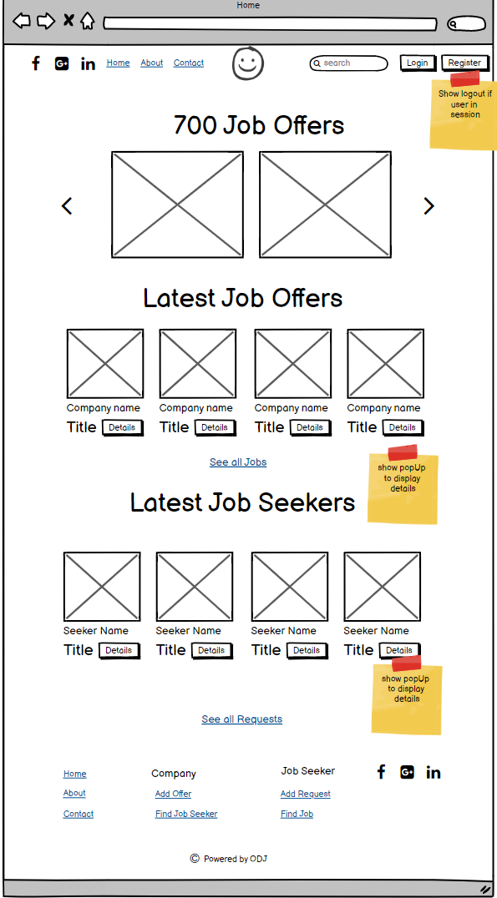
WireFrame Creation
Creating the wireframe of all pages using balsamiq.
Creating the timeline using Google sheet
Creating the user story using Trello
the timeline
Home page WireFrame

Slide 3
Database Design

Slide 4
Home Page

